Slide 1
DATA COLLECTION

Slide 2
INTRODUCTION
Data has always served to enhance understanding,
It enables a decision maker to better choose among many options.
Individuals look to data to assist them in their decision-making process.
Data may be used to
  predict the future,
  report on the past, or
  indicate what is currently happening
GIT 1201

Slide 3
INTRODUCTION …
Data can take the form of;
  numbers, text, graphics (charts, tables, pictures, maps, etc.), verbal exchanges (e.g., conversations)
Data Collection is obtaining useful information
Or:
  A systematic, logical method to collect raw information that accurately and reliably represents the variable(s) or field(s) under study.
The issue is not: How do we collect data?
It is: How do we obtain useful data?
GIT 1201

Slide 4
WHY COLLECT DATA?
To establish a factual basis for making decisions;
  I think the problem is . . .
  becomes
  The data indicate the problem is . . .
  It provides the best possible data given the constraints (i.e., restrictions) that will enable a decision maker to make the best possible decision.
  NB: It is necessary to have a data collection plan
GIT 1201

Slide 5


DATA COLLECTION PLAN
To collect data uniformly, you will need to develop a Data Collection plan.
The elements of the plan must be clearly and unambiguously defined—operationally defined.
Collection Plan: A detailed document that describes the exact steps as well as the sequence that needs to be followed in gathering the data
GIT 1201

Slide 6
WHY A DATA COLLECTION PLAN
You will have collected data, but it probably won't be much good to you.
You may make changes to your process based on flawed information.
  When operational definitions are not clear,
  each data collector will observe and record data based on his/her understanding of the situation.
  The Data Collection process will not be standardized or consistent.
GIT 1201

Slide 7
WHY A DATA COLLECTION PLAN?...
  Data Collection can involve a multitude of decisions by data collectors.
  When you prepare a Data Collection plan, try to eliminate as many subjective choices as possible by operationally defining the parameter needed to do the job correctly
GIT 1201

Slide 8
WHY A DATA COLLECTION PLAN?...
  Collect uniform data
  Ensures useful data is collected
  Maintain quality
  Reinforcing appropriate method of collection
  Understand the data sources
  Strengths/opportunities to take advantage of
  Collect data within schedule
  Provides structure and consistency around data to be collected
GIT 1201

Slide 9
CHALLENGES
Common challenges in data collection include;
Poor choices of methods: Choosing the ‘same old’ methods regardless of their suitability to the specific evaluation.
Poor implementation of methods: This ranges from poor execution of sampling to poor quality data collection such as,
  poorly constructed questionnaires;
  failing to give people the opportunity to really talk during interviews;
GIT 1201

Slide 10
WHO WILL COLLECT THE DATA?
Workers who perform process steps:
Those closest to the data—the process workers.
  These people have the best opportunity to record the results. BUT
Properly trained: The people who are going to collect the data need training on how to do it
Well equipped: The resources necessary to obtain the information, such as time, paper, pencils, and measurement tools provided.
GIT 1201

Slide 11
HOW DO WE COLLECT THE RIGHT DATA?
Remember that you are collecting data for the purpose of improving the process,
Not the product it produces.
  Small sample sizes at small intervals
  Collect frequently
  Dependent on availability of data, cost, consequences
GIT 1201

Slide 12
DATA COLLECTION PROBLEMS TO AVOID
Problem 1 - Failure to establish Operational Definitions (plan). You need to define, not simply identify, the following:
  When and how often you will collect the data
  How you will collect the data
  Units of measurement you will use in collecting the data
  The criteria for defects
  How you will handle multiple defects on single products
GIT 1201

Slide 13
DATA COLLECTION PROBLEMS TO AVOID…
Problem 2 - Adding bias to the Data Collection process. You can never eliminate bias, but it is important to minimize it. How can data be biased:
  The process of collecting the data may affect the process being studied.
  If you are trying to make a process faster, taking data may either speed it up or slow it down.
GIT 1201

Slide 14
DATA COLLECTION PROBLEMS TO AVOID…
  Problem 3- Failure to follow the established Data Collection procedures can add errors to the data.
  This bias occurs when the Data Collection instructions, training, or check sheets are not adequately prepared and tested in an operational environment.
GIT 1201

Slide 15
DATA COLLECTION PROBLEMS TO AVOID…
Problem 4- Assumption of missing data. Don't assume that missing data will show the same results as the data you collected.
  Missing data may be different from the rest.
  Number the check sheets sequentially to verify that you have them all and all the required samples are taken
GIT 1201

Slide 16
CATEGORIES OF INFORMATION
These include:
Information about the Organization
Information about the People
Information about the Work
Information about the Work Environment
GIT 1201

Slide 17
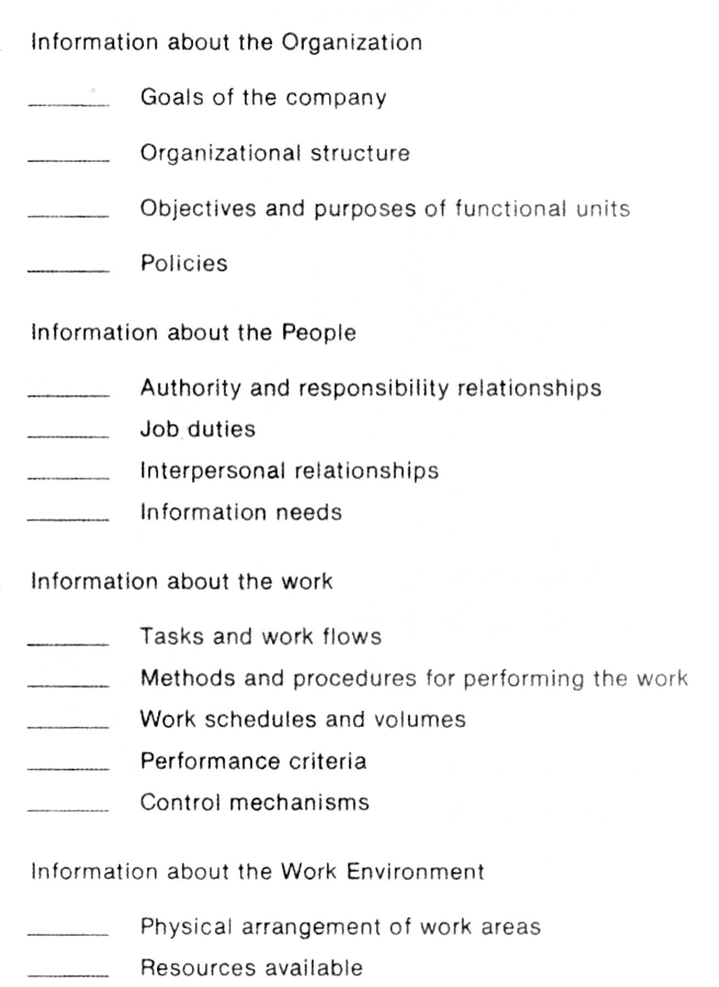
CATEGORIES OF INFORMATION CHECKLIST
GIT 1201

Slide 18
CATEGORIES OF DATA
Data fall into two major classifications.
  Primary Data
  Secondary Data
GIT 1201

Slide 19
PRIMARY DATA
Primary data: Primary data is collected with the aim of being foundation for the analyses in your investigation
Any information that is collected or produce for a particular research assignment
It is the type of data that is collected by researchers directly from main sources
Data that has never been gathered before, whether in a particular way, or at a certain period of time.
Gathered when data cannot be found from outside sources.
GIT 1201

Slide 20
PRIMARY DATA…
BUT Can be extremely costly and,
If associated with a college or institute, requires permission and authorization to collect such data
Primary data collected through:
  Measurement
  Interviews
  Questionnaires
  Observations
GIT 1201

Slide 21
SECONDARY DATA
Secondary Data: Secondary data is collected for other purposes
It is the data that has already been collected through primary sources and made readily available
Data that were collected for other purposes and are being used secondarily to answer a research question.
If the time or hassle of collecting individual data is too much, or
  the data collection has already been done, secondary data may be more appropriate
GIT 1201

Slide 22
SECONDARY DATA…
Data typically comes from other studies done by other institutions or organizations.
Formerly primary data which was collected for research in the past
No less validity with secondary data, but you should be well informed about how it was collected
Secondary data collected through:
  Literature review
GIT 1201

Slide 23
SECONDARY DATA…
When is secondary data appropriate?
  As a foundation for your own work
  When you want to know what, and how, things are done by others
  When you want to know how others have interpreted situations or occurrences
  When it is impossible to get primary data
GIT 1201

Slide 24
QUANTITATIVE AND QUALITATIVE DATA COLLECTION METHODS
Quantitative research is the process of collecting and analyzing numerical data
Quantitative Data: data that can either be counted or compared on a numeric scale
Deals with numerical content
Used when a researcher is trying to quantify a problem, or
address the "what" or "how many" aspects of a research question.
GIT 1201

Slide 25
QUANTITATIVE
It is numerical data, which can be categorized or put into a rank order
It is often gathered through surveys and questionnaires that are carefully developed and
Structured to provide numerical data that can be explored statistically and
Yield a result that can be generalized to some larger population
GIT 1201

Slide 26
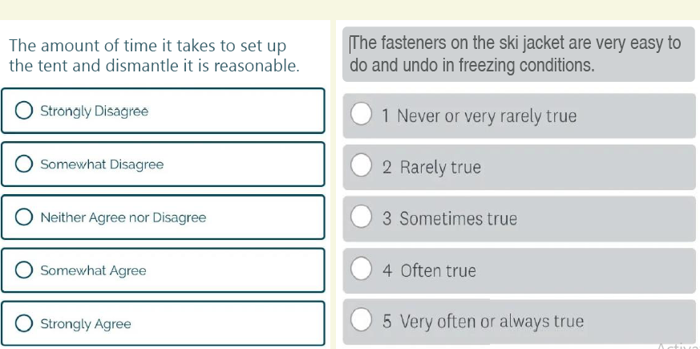
This type of information is easy to collect and summarize.
It is most useful when taken from large groups of people.
An example of a Quantitative survey
GIT 1201

Slide 27
QUALITATIVE RESEARCH
It is exploratory research and seeks to explain ‘how’ and ‘why’ a particular phenomenon operates as it does in a given context.
Deals with descriptive content
Qualitative research often investigates;
  Local knowledge and understanding of a given issue or programme;
  People’s experiences, meanings and relationships
  social processes and contextual factors that marginalize a group of people or impact a programme.
GIT 1201

Slide 28
QUALITATIVE RESEARCH…
Qualitative data or information is:
  Descriptions from opinions or observations –
  it uses words to describe a quality or characteristic
  Aspects that are not easily measured,
This type of information can be;
  complex,
  difficult to interpret,
  harder to analyze and
  usually expensive.
It is often done with smaller numbers of people.
GIT 1201

Slide 29

QUALITATIVE RESEARCH…
Qualitative data is often gathered through;
  individual interviews and
  focus group discussions using semi-structured or unstructured topic guides
  observing what they do and how they interact with/use products
GIT 1201

Slide 30
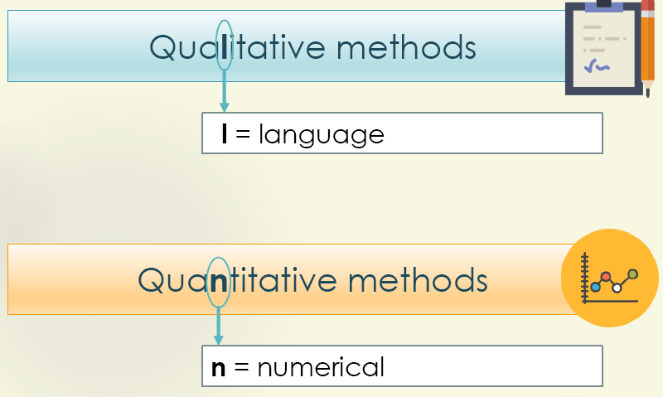
TIPS FOR REMEMBERING
GIT 1201

Slide 31
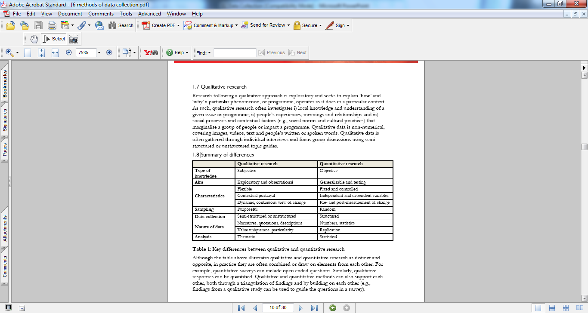
QUALITATIVE VS. QUANTITATIVE
GIT 1201

Slide 32
QUANTITATIVE AND QUALITATIVE DATA COLLECTION METHODS…
Typical quantitative data gathering strategies include:
Experiments/clinical trials.
Observing and recording well-defined events (e.g., counting the number of patients waiting in emergency at specified times of the day).
Obtaining relevant data from management information systems (Literature).
Administering surveys with closed-ended questions (e.g., questionnaires etc)
GIT 1201

Slide 33
INTERVIEWS
The most common data collection method used to collect primary source information
An individual interview is a conversation between two people that has a structure and a purpose.
Driven by the use of questions that produce responses that are related to the research goals.
Ideal for collecting detailed and descriptive information
Designed to elicit the interviewee’s knowledge or perspective on a topic.
GIT 1201

Slide 34
How to collect information using an interview
  Preferably interview one-to-one
  Listening tactics - encourage interviewee to talk
  Minimal note taking
  Use a cassette?
  Avoid leading questions
  Write interview notes immediately after interview
As courtesy, send written thanks for interview accompanied by your interview summary
GIT 1201

Slide 35
INTERVIEWS…
Unsuccessful interviews
  Not all interviews are successful
  Find a way to conclude an unsuccessful meeting
  Consider alternatives
Interviews may be conducted by using the following tools:
Telephone interviews - A one-on-one, directed conversation that occurs over the telephone.
Less time consuming and less expensive
The researcher has ready access to anyone on the planet who has a telephone.
GIT 1201

Slide 36
INTERVIEWS…
  Disadvantages: the response rate is not as high as the face-to- face interview but considerably higher than the mailed questionnaire
Personal Interview – A one-on-one, directed conversation that occurs face-to-face.
Computer Assisted Personal Interviewing (CAPI): respondent or interviewer uses electronic device (tablet, mobile phone, laptop) to record responses
GIT 1201

Slide 37
INTERVIEWS…
ADVANTAGES
DISADVANTAGES
Personal contact - face-to-face
Flexible and adaptive
Interviewer can probe for further detail
Best source of qualitative information
Useful for respondents who do not communicate properly in writing
Time consuming
Evaluation of information can be difficult
Biased by interviewer
Need well-qualified, highly trained interviewers
Communication problems
Misunderstandings can rise from different user values, or technical jargons.
GIT 1201

Slide 38
QUESTIONNAIRES
Special-purpose documents that allow one to gather facts from a large number of people while maintaining some control over their responses.
An approach that gathers primary source information by presenting a series of questions to be answered
Requests specific information from respondents
Impersonal
Often mass produced
Guidelines …..
  Bear in mind the level of intellect and the level of interests of the respondents
GIT 1201

Slide 39
QUESTIONNAIRES…
  Keep questions short, unambiguous and unbiased, and where possible have multi-answers.
  Pretest the questionnaire before using it
People are more truthful while responding to the questionnaires regarding controversial issues in due to the anonymous responses
Ideal for collecting a large amount of information
But they also have drawbacks.
GIT 1201

Slide 40
QUESTIONNAIRES…
ADVANTAGES
DISADVANTAGES
Most economical from large number of people
Administered quickly and easily
Results can be analyzed quickly
Can get reliable information due to anonymity.
Allow collection of data and can be filled in at leisure.
Effective questionnaires are difficult to construct
Need several drafts and trial mailing
Gathers only limited amount of data
No flexibility to adapt to each respondent to probe more deeply
Misinterpretation of the question.
GIT 1201

Slide 41
OBSERVATION
  Gathering information by watching and recording actions, behaviors, and conduct in natural settings
  The least common data collection method to collect primary source information
  often used when validity of data collected through other methods is in question
  People usually feel uncomfortable when being watched.
Observe actual processing associated with the system
Data gathered based on what is seen (not on what people say happens in the system)
GIT 1201

Slide 42
OBSERVATION…
Advantages of Observations
  Permits correction of any misconceptions or erroneous impressions made before.
  Permits verification of statements made in interviews.
  Independent of People’s Willingness to Report:
  Researcher becomes better acquainted with the operating personnel
  information gathered is “highly believable”
GIT 1201

Slide 43
OBSERVATION…
Disadvantages
Logistic problems (Expensive)
  Requires sophisticated equipment’s.
  organization and implementation issue
Performance of people being observed may be affected by the observer’s presence
Trained people needed for observations
Sample observation form
Personal Bias of the Observer
Observation is a time taking process.
GIT 1201

Slide 44
DOCUMENT REVIEW/RESEARCH/LITERATURE
Involves collecting secondary information from existing sources
A useful fact-finding technique is to research the application and problem.
Common sources include
  Computer trade journals,
  reference books,
  Professional publications (articles, reports) and
  the Internet
GIT 1201

Slide 45
DOCUMENT REVIEW/RESEARCH/LITERATURE…
Provide information on how others have solved similar problems,
You can also learn whether or not software packages exist to solve your problem
GIT 1201

Slide 46
DOCUMENT REVIEW/RESEARCH/LITERATURE…
ADVANTAGES
DISADVANTAGES
Can be time-consuming
Requires access to appropriate sources of information
May ultimately not help in solving problem because problem is not documented elsewhere
Can save time if solution already exists
Researcher can see how others have solved similar problems or met similar requirements
Keeps researcher up to date with current developments
GIT 1201

Slide 47
FOCUS GROUPS
Combine elements of both interviewing and participant observation.
It is, indeed, an interview—not a discussion group, problem-solving session, or decision-making group.
Focus groups. A gathering of people who share some characteristics relevant to the evaluation.
  It is a face-to-face interview with a group of individuals
  Typically ranging from 2-12 individuals).
  Originally used as a market research tool,
  The technique has been adopted by other fields.
GIT 1201

Slide 48
WHEN TO USE FOCUS GROUPS
Specific applications of the focus group method include:
Identifying and defining problems in project implementation
Pretesting topics or idea
Identifying project strengths, weaknesses, and recommendations
Assisting with interpretation of quantitative findings
Obtaining perceptions of project outcomes and impacts and Generating new ideas
GIT 1201

Slide 49
MODERATING THE DISCUSSION
An experienced focus group moderator should conduct the sessions.
Moderating the discussion is difficult, and
Effective leadership is essential for group to accomplish its purpose.
The following key points should be considered:
Keep the conversation flowing. The moderator needs to keep control of the discussion session.
GIT 1201

Slide 50
MODERATING THE DISCUSSION
Length of discussion. Each session should last approximately 90 minutes.
Be neutral. One benefit of having an outside person moderate the discussion is that the person can be neutral.
NOTE
the moderator or a neutral observer should write a report describing the discussion for the Assessment Work Group.
GIT 1201

Slide 51
SELECTING A DATA COLLECTION METHOD
The goal of data collection is to gather enough accurate and relevant data
no one data collection method/tool is ideal for every situation
A number of factors must be considered when deciding which data collection method/tool(s)
  Research questions and goals
  Participant/unit sample
  Response rates, time, & cost
  Research experience
  Quality of data
GIT 1201

